Slide 1
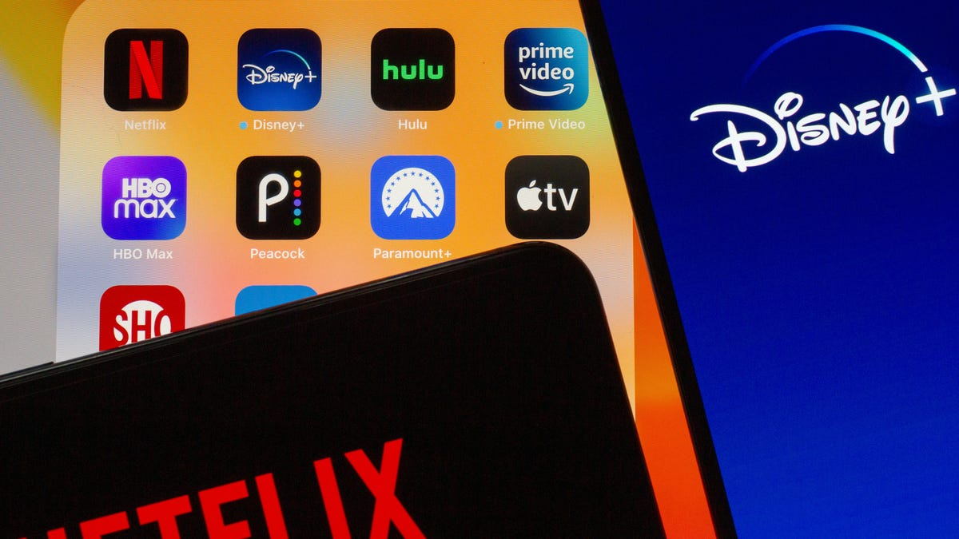

CS550: Massive Data Mining Movie Recommendation System
Group 29:
Shreyas Kulkarni (spk111)
Udit Wadhera (uw17)
Professor
Yongfeng Zhang

Slide 2
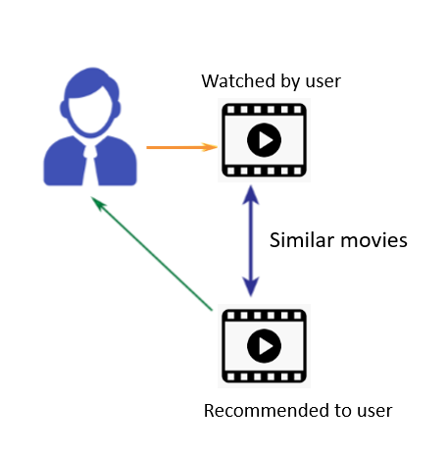
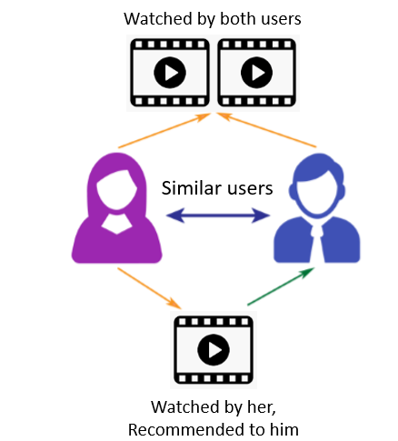
Problem Statement
Desgin and build a movie recommendation system based on ‘MovieLens’ dataset.

Slide 3

DataSet
MovieLens review dataset (ml-latest-small)
Ratings: 100k
Movies: 9k
Users: 600
Integrated the dataset with TMDB dataset
Notes:
The primary dataset used for this project is the movielens review dataset. consisting of 27,753,444 reviews over 58,098 different movies by 283,228 users.

Slide 4
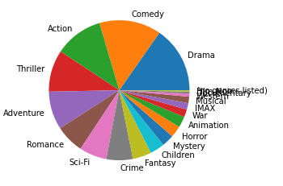
Data Analysis
Distribution of Genre

Slide 5
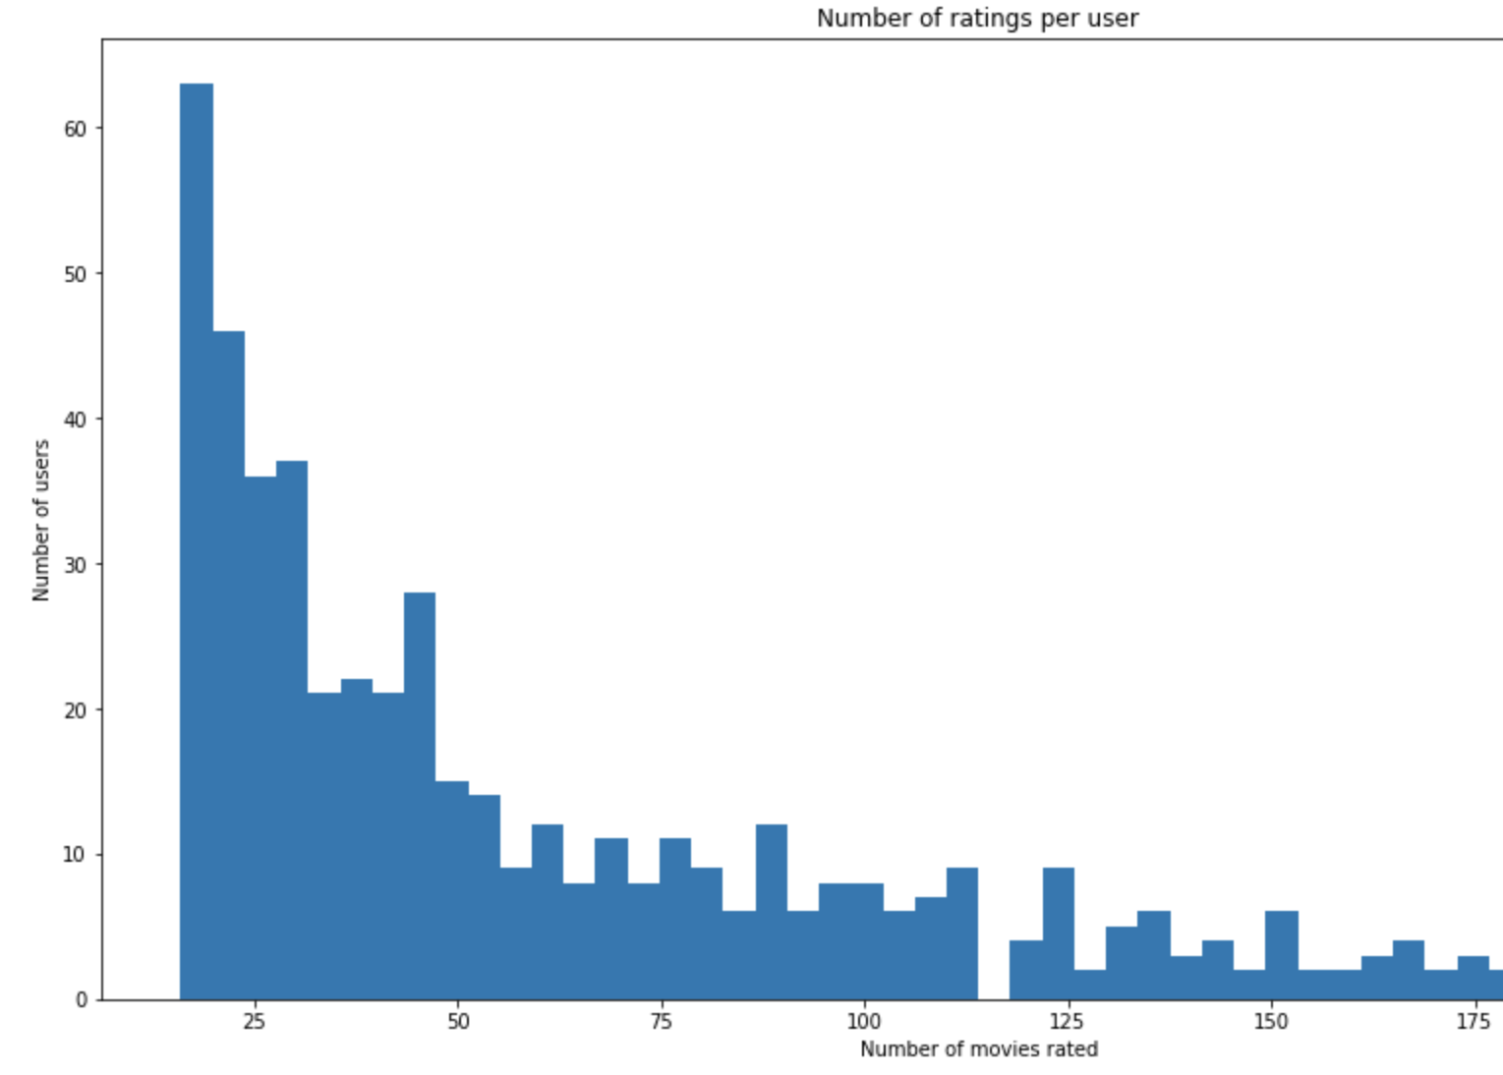
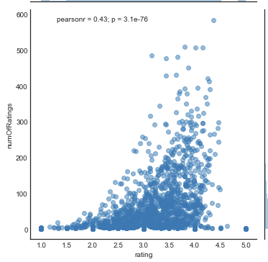
Data Analysis
Number of ratings per user

Slide 6
Models used
Popularity based model
Content based model
Collaborative Filtering
Matrix Factorization method
Combined model ( SVD + CF)

Slide 7
Popularity Model
Genre wise popular movies
Computed on:
Popularity metric from TMDB data

Slide 8
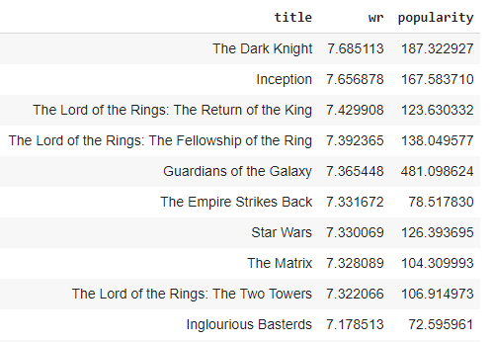
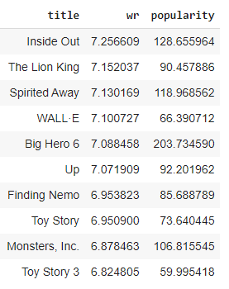
Action Movies Animated Movies

Slide 9
Content-Based Recommendation
User profile based on item profiles
Genre
Year of release of movie

Slide 10
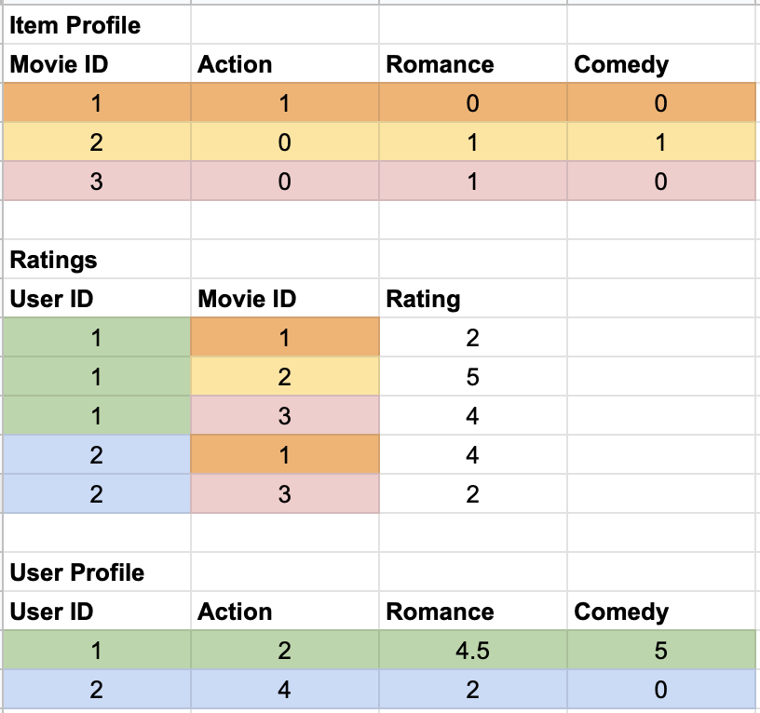
User and Item Vectors
Item Vector:
Vector of length total genres with 1 at relevant indices
User Vector:
Vector of length total genres with the value of average rating for each genre based on ratings in train set
Notes:
Item profile = Based on the the genre list for each movie, we build a movie profile. Example movie 1 belongs to genre [“Action”],movie 2 is a RomCom movie, and so on.
Using the ratings data, which has ratings for a movie by the user, we build a user profile.
Each entry in the user profile vector depicts the affinity of the user for that specific genre.

Slide 11
Evaluation metrics
Metric | Content based (Genre)
RMSE | 0.9199
MAE | 0.7085
Metric | Content based (Genre)
Precision | 0.800932214
Recall | 0.495168862
F-Measure | 0.6119842046
NDCG | 0.945576877

Slide 12
Collaborative Filtering
KNN (k- nearest neighbors) algorithm using Surprise library
Variations of KNN based approaches:
KNNBasic
KNNwithMeans
KNNWithZScore
KNNBaseline : integrates the baseline estimate ratings
Similarity metrics:
Cosine similarity
Mean square difference-based similarity
Pearson coefficient (mean-centered cosine similarity)
Pearson Baseline (uses global baselines for centering instead of means)
Notes:
Pearson Baseline: This method computes the Pearson correlation coefficient between all pairs of users (or items) using baselines for centering instead of means.

Slide 13
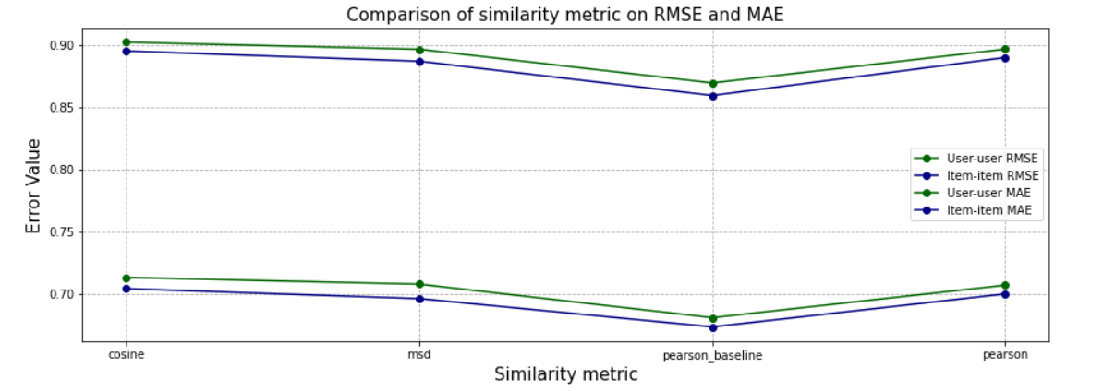
User-User and Item-Item comparison

Slide 14
Latent Factor Methods
Matrix Factorisation algorithms using Surprise library
SVD : baseline estimates + latent factor predictions
SVDpp : SVD + considers implicit ratings
Hyperparameter tuning using GridsearchCV

Slide 15
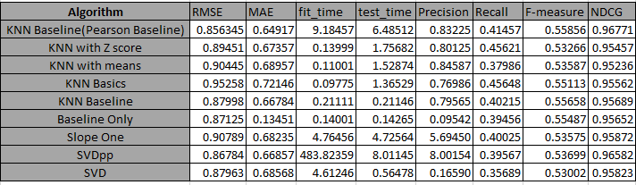
Comparisons of various Algorithm
Notes:
SVD++

Slide 16
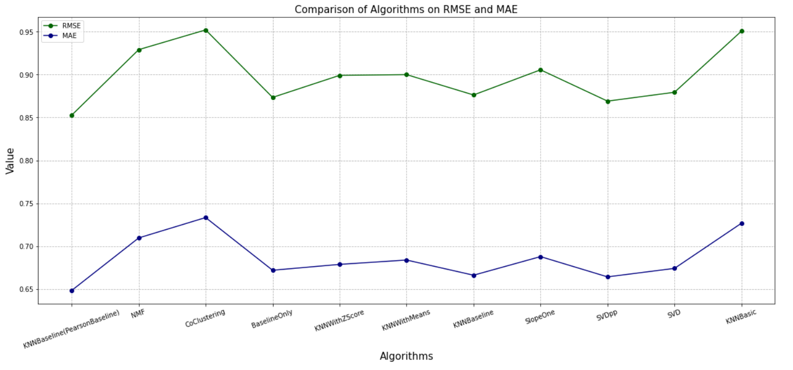
RMSE vs MAE for different algorithms

Slide 17
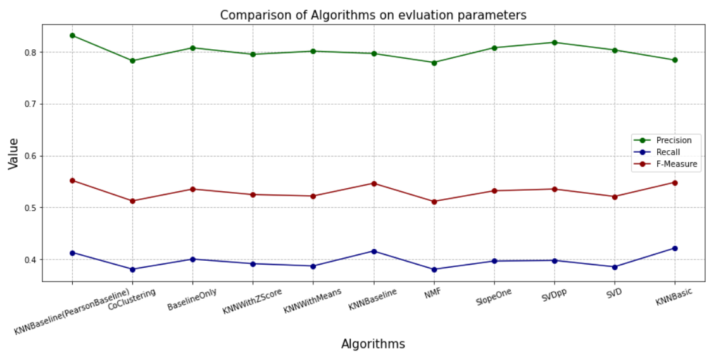
Evaluation of different algorithms

Slide 18
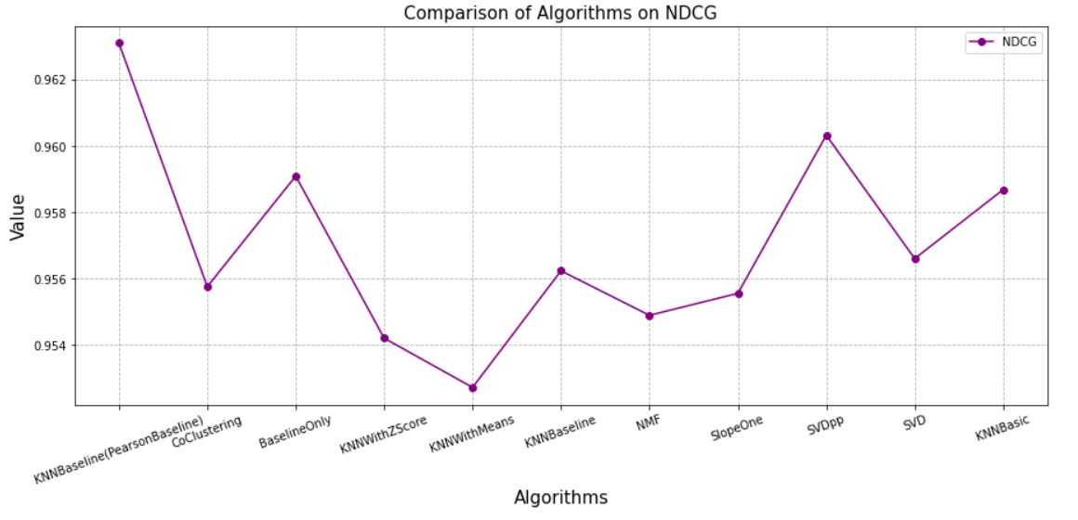
NDCG scores for different algorithms

Slide 19
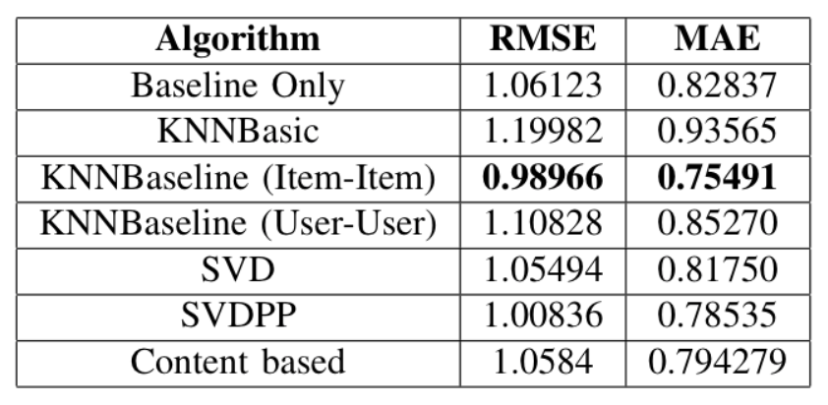
Which model is best for less ratings in training data?
(Less than 18 ratings per user)

Slide 20
Combined Model
Matrix Factorization + CF
Combined:
KNNBaseline (with pearson baseline similarity)
SVDpp
SVD
BaselineOnly

Slide 21
Weighted Combination of the best Algorithms
SVD | KNNBaseline (PearsonBaseline) | SVDPP | Baseline | RMSE | MAE | Precision | Recall | F-Measure | NDCG
0 | 0 | 1 | 0 | 0.8626 | 0.6735 | 0.79921 | 0.33642 | 0.47352 | 0.95872
0 | 1 | 0 | 0 | 0.8527 | 0.6482 | 0.81984 | 0.36242 | 0.50264 | 0.96310
0 | 0.6 | 0.4 | 0 | 0.844 | 0.6427 | 0.82732 | 0.35428 | 0.49611 | 0.96637
0.05 | 0.6 | 0.35 | 0 | 0.84405 | 0.6427 | 0.82836 | 0.35424 | 0.49626 | 0.96731
0.1 | 0.5 | 0.3 | 0.1 | 0.84405 | 0.6433 | 0.83139 | 0.35040 | 0.49301 | 0.96614

Slide 22
Conclusions:
Content based with genre is good when a user has less ratings.
Item-item collaborative filtering is found to be working better with user-user collaborative filtering.
When different models' predictions and recommendations are combined, the accuracy and quality of the recommendations improves.

Slide 23
Thank you!

